Slide 1

Chinook Music Services Sales Analysis
Shahbaaz Shaikh

Slide 2
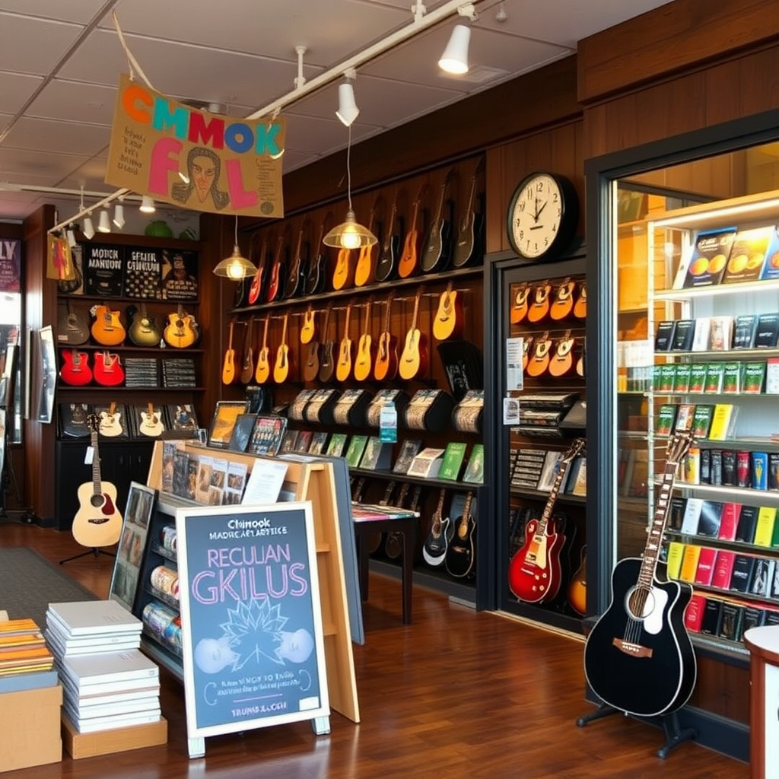
About Chinook
Chinook Music Services stands as a leader in the physical music records market, delivering unparalleled musical entertainment across the globe. With a vast network of outlets and services, Chinook brings a rich and diverse genre experience to customers everywhere. By offering a wide array of musical styles and albums, Chinook ensures every customer finds their rhythm, connecting people through the universal language of music.
Our commitment to quality, diversity, and global reach makes Chinook a trusted name for music enthusiasts worldwide.

Slide 3
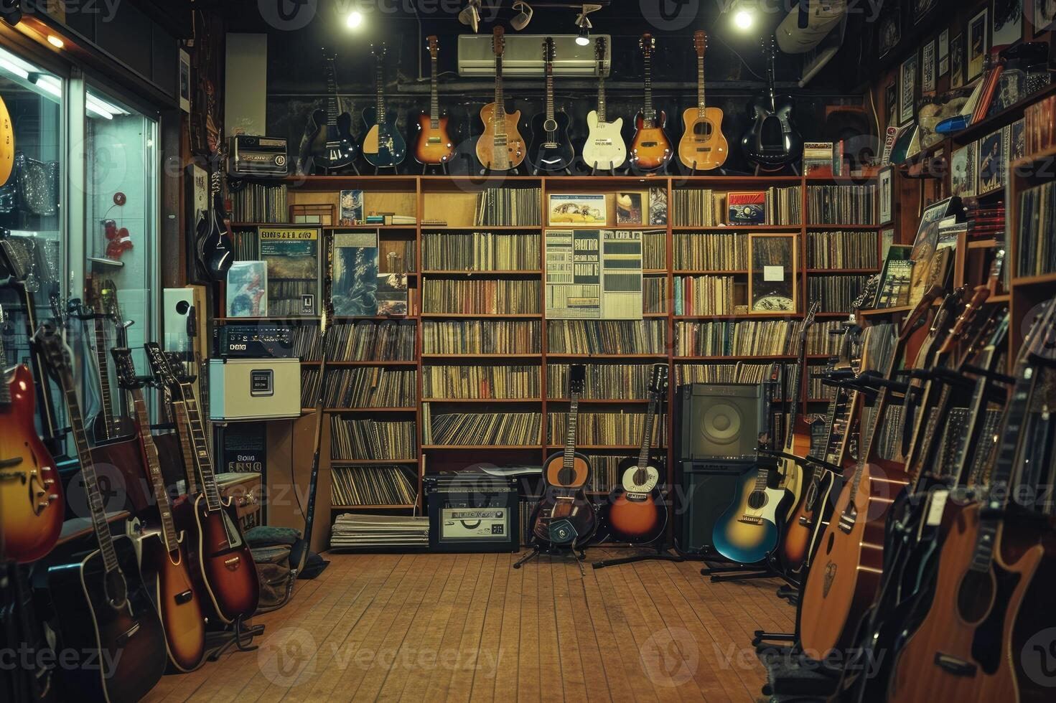
Problem Statement
Sales Analysis
To analyze music record sales data to gain insights and make recommendations for the company's strategy in the physical music market.
Market Analysis
To derive insights based on the geographical location of customers and recommend strategies to increase company revenue.

Slide 4
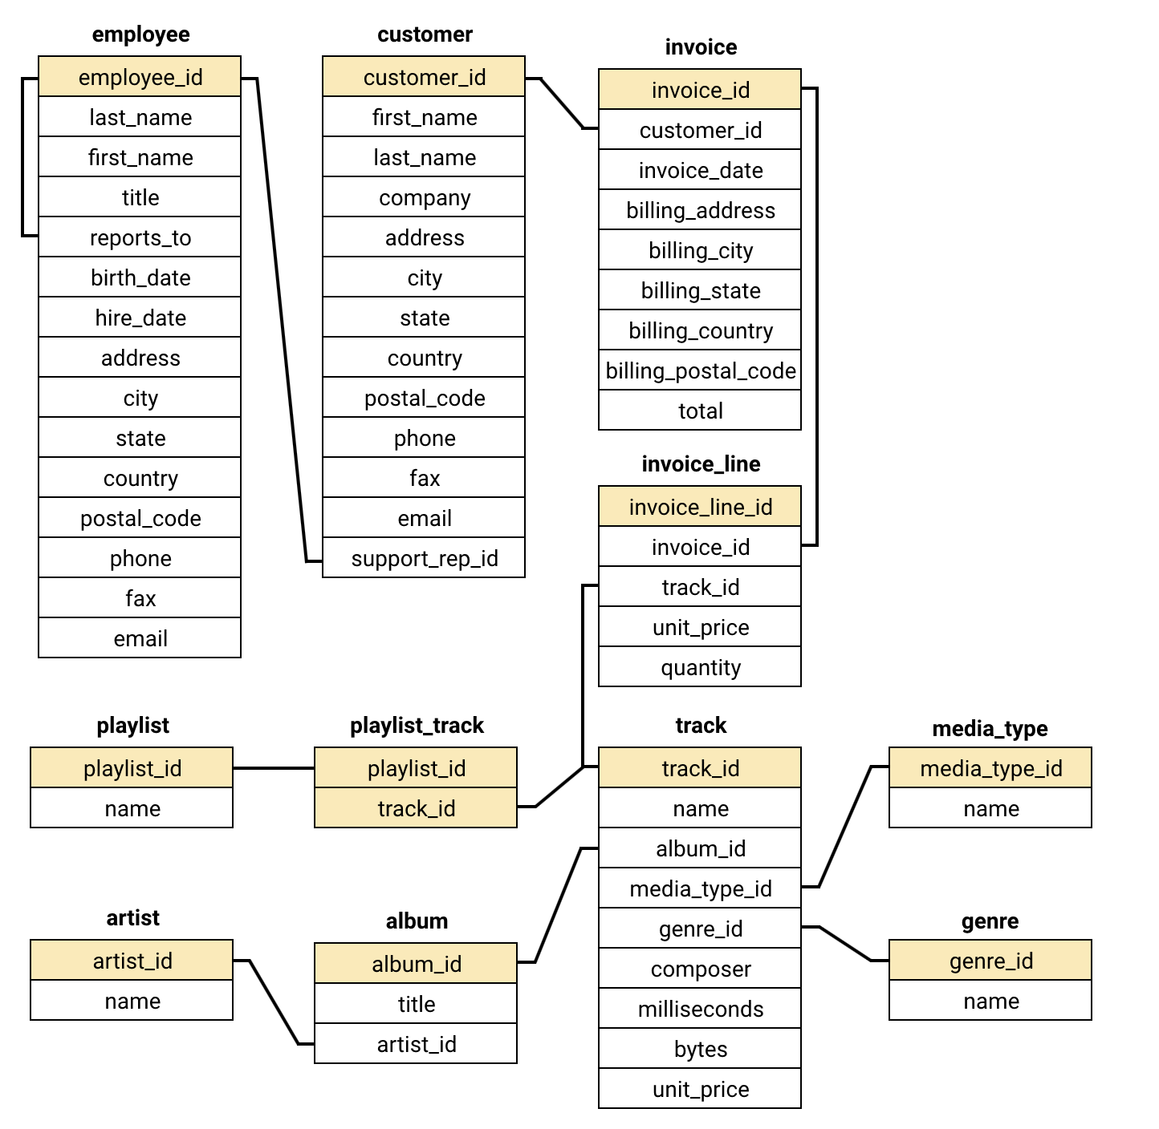
Database schema

Slide 5

Data overview
The dataset consisted of 11 tables containing data related to the company.
The company has customer base from 24 different countries across the globe.
The tracks sold are of 25 different genres including rock, metal, jazz & many more.
It also includes information regarding the album and the artist related to a track.
The invoice table records all the transactions in the company.

Slide 6
Understanding the Data
Data Integrity
Key Metrics
No Missing Values: The dataset contains no missing values, ensuring a complete and accurate foundation for analysis.
No Duplicates: A thorough check revealed no duplicate entries, confirming the data’s reliability.
Clean and Consistent: The dataset is well-maintained, free from inconsistencies, and ready for detailed analysis.
Reliable Basis for Insights: The data’s quality supports meaningful interpretations and informed business decisions.
Sales Data: Analyzed sales data to identify total revenue, average order value, and sales trends over time.
Customer Demographics: Examined demographic information, including age, gender, and location, to identify key customer segments.
Geographical Location: Evaluated regional sales performance based on geographical data to identify high-performing areas.

Slide 7

Customer Profile & Top Sellers
Target Audience
Popular Tracks
Chinook’s customer base is primarily located in the USA, UK, and Canada, representing the company’s key markets.
“Rock” is the top-selling track, with “The Posies” being the most popular artist. “Rock” and “Metal” are the dominant genres.

Slide 8

Customer Retention & Growth
1
Long-Term Customers
2
Churn Rate
Long-term customers show a higher frequency of purchases, indicating successful customer retention efforts.
A calculated churn rate of 32.43% highlights the need for customer retention strategies to minimize customer loss.

Slide 9




Genre Analysis & Insights
Rock
Rock remains a consistent favorite, demonstrating a steady fanbase and potential for promotional campaigns.
Pop
Pop continues to dominate sales in the USA,
aligning with broader musical trends.
Jazz
Jazz has a dedicated following, suggesting potential for targeted marketing strategies within this niche genre.

Slide 10
Customer Segmentation
Top Spenders
Genre Preferences
Jack Smith, the highest spender in the USA, presents an opportunity to enhance loyalty programs.
A tiered system with exclusive discounts and personalized offers can boost engagement.
Personalized offers based on their purchase history, such as preferred genres and buying frequency, can drive sales.
Rock and Metal are the most popular genres among customers, presenting opportunities for personalized marketing.
Targeted campaigns featuring new releases or curated playlists based on purchase history can boost engagement.
Cross-promoting similar artists or genres may also drive repeat purchases and enhance brand loyalty.

Slide 11
Customer demographic breakdown based on location of chinook's customer base?
Key points :-
The customer base of chinook is diverse, covering 24 countries.
The customer demographic breakdown is very diversified.
The majority of customers are from the USA.
Chinook’s customer base is primarily located in the USA, UK, and Canada.

Slide 12
Calculate the percentage of total sales contributed by each genre in the USA
Key points :-
The top-selling genre in the USA is rock which is 53.9% respectively
The 2nd and 3rd most selling genres are alternative & punk and metal with 12.37% & 11.8%

Slide 13

What is the customer churn rate?
Insights:-
The customer churn rate of the company is 32.432 based on the total number of customer
Key points :-
It shows that the customer retention is not good in the company.
The number of customers lost are high and needs immediate action to maintain the customer base.

Slide 14
Customer purchasing behavior analysis:
Insights:-
The spending amount, basket size, and purchase frequency are higher for long-term customers compared to short-term customers.
Recommendation :-
Customer loyalty significantly contributes to increasing company revenue, as long-term customers tend to make more purchases than short-term customers.
Therefore, the company should focus on improving customer retention rates to drive sustained sales growth over time.

Slide 15
Customer Risk Profiling:
Insights:-
After analyzing the data through chart. Countries with high spending and order frequency are growing, while others remain stagnant. Recommendation :-
The overall sales per month has a decreasing trend which shows that the sales had gone down during the 2nd last quarter .
But during last quarter sales are again increasing.
Therefore, it is seen that new promotional campaigns need to be done in those countries to reduce churn rate as well as maintain & increase the spending.

Slide 16




Strategic Recommendations
Customer Retention
Focus on strategies to retain existing customers, such as loyalty programs and personalized recommendations.
Targeted Marketing
Develop specific marketing campaigns targeting profitable genres and customer segments to maximize revenue.
Genre Expansion
Explore opportunities to introduce new and emerging genres to broaden customer appeal and appeal to new markets.

Slide 17

Conclusion
Chinook has a strong position in the physical music market with a loyal and consistent customer base.
Long-term customers exhibit steady purchasing behavior, creating opportunities to strengthen engagement and boost sales.
Enhancing the loyalty program, personalizing customer recommendations, and targeting high-potential genres can increase customer satisfaction and drive revenue growth.
A strategic focus on personalized marketing and data-driven insights will solidify Chinook’s industry leadership and foster sustainable growth.
Leveraging these recommendations ensures long-term success and profitability in a competitive market.

Slide 18
Thank you

